Slide 1

DEPI Software testing

Slide 2
MEET THE TEAM
Menna-Allah abdalmoaty
Ahmed Mohamed
Momen Maged
Ahmed Salah
Doha Abdelazeim
Abd Al-Rahman Nageh

Slide 3
purpose
Functional Testing
Comprehensive Manual Testing
Validate User Interface
he project will test all core functionalities of the website. This includes user registration, login and logout procedures, product Browse and search capabilities, shopping cart management, and the complete checkout process. Additionally, the contact us form and subscription features will be validated.
Manually test key user journeys such as registration, login, product Browse, adding to cart, and the complete checkout process to ensure they are intuitive and functional.
Potential risks such as browser compatibility issues, fluctuations in API response times, and errors from unexpected user inputs have been identified. The testing process will aim to uncover and address these risks.

Slide 4
Test Scope
User registration
Login
Product Browse
Shopping cart
checkout
Product review
Website navigation
Scroll function

Slide 5

Project goals
Ensuring User Experience
Ensuring System Reliability
Comprehensive testing

Slide 6
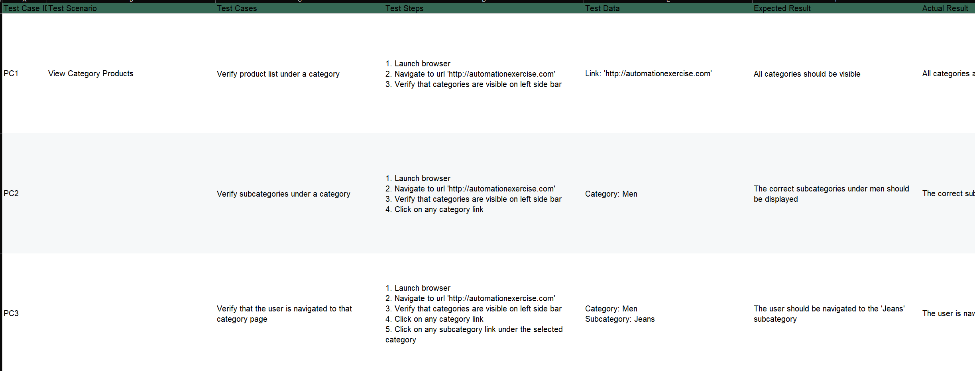
Manual Testing

Slide 7
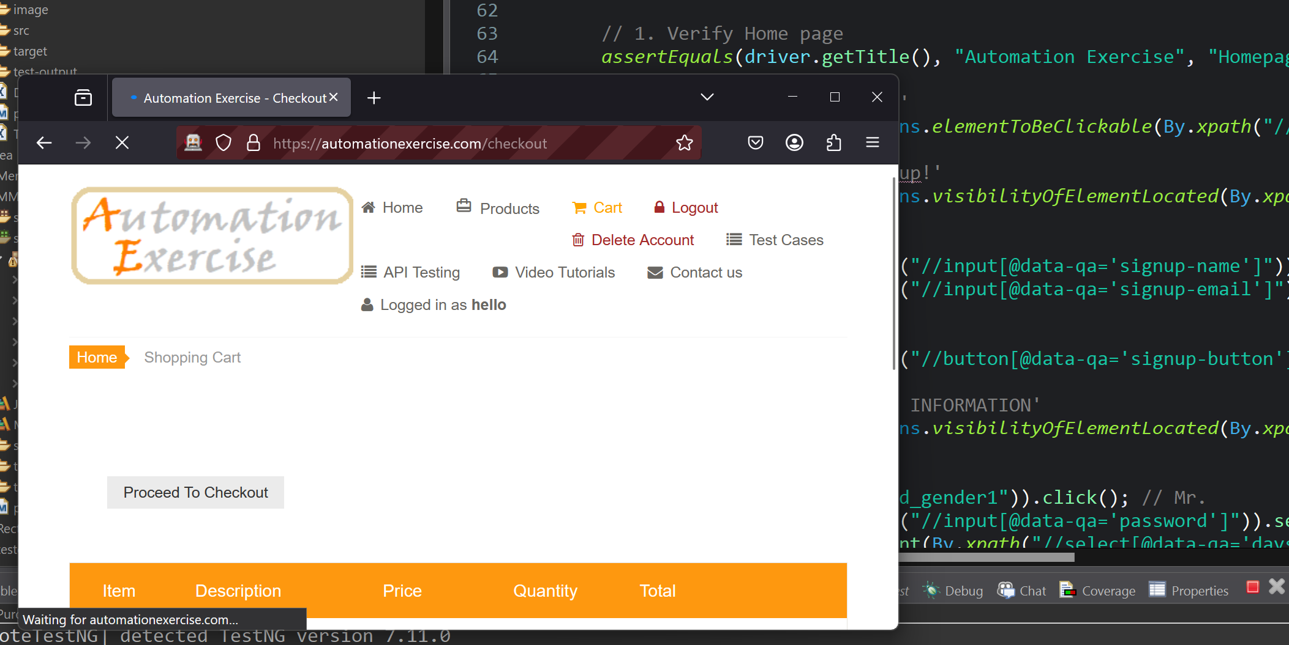
Automation

Slide 8
Menna
Login positive scenario
Login Negative scenario
Logout scenario
Register positive scenario

Slide 9
Doha
Register negative scnario
Contact us
Product Browse
Shopping cart

Slide 10
Ahmed salah
Search product
Verify subscription homepage
Verify subscription cart page
Shopping cart

Slide 11
Abdo nageh
Verify product quantity
Register while checkout
Register before checkout
Login before checkout

Slide 12
Ahmed Lotfy
Remove products from cart
View category products
view cart and brand products
Search products and verify client

Slide 13
Momen Maged
Add review on product
Add to cart from recommended items
Verify address details in checkout
Download invoice
Verify scroll up using arrow
Verify scroll without arrow

Slide 14
Thank you!

